Slide 1
Exploring Songs Dataset using AWS Tools
By Abigail Frost, Kaylene Noel, and Jon Skende

Slide 2
Why We Chose This Project
We chose this project because music is a significant source of entertainment in our modern world. However, there are millions of songs, making it difficult to keep track of and manage the data for each one. Traditional data analysis and preprocessing are impractical due to the size of the dataset.

Slide 3
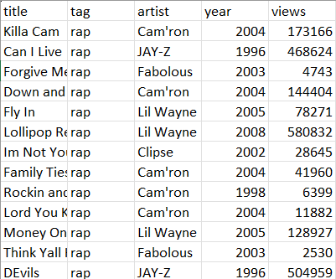
Dataset
Downloaded the set “English Song Lyrics” from kaggle.com
7 Attributes:
X: unique number (1 - 3,373,529)
title: the name of the song
tag: the genre the song is classified as
artist: the singer
year: the year the song was released
views: the number of people that listened to the song
lyrics: song’s lyrics
3,373,529 rows

Slide 4

Preprocessing
Used R Studio for preprocessing
Checked for missing values
Deleted the following attributes:
X
lyrics
Created a new csv file without the deleted attributes

Slide 5
What Our Project Does
Organizes this large dataset so finding a song title, artist, genre can be made easier.
Allows users to discover new songs or artists based on their desired criteria.
Discover the amount of views based on a range of years

Slide 6
Tools
S3 Bucket
EC2 Instance
Fix timeout error
EMR Clusters
Hadoop
Spark
CloudFront

Slide 7
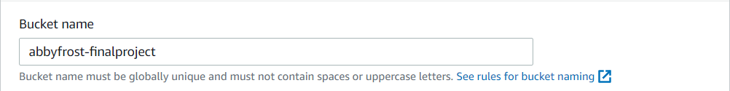
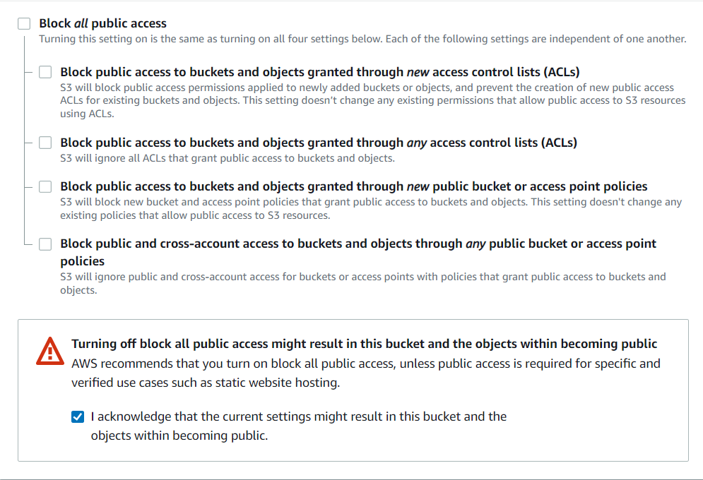
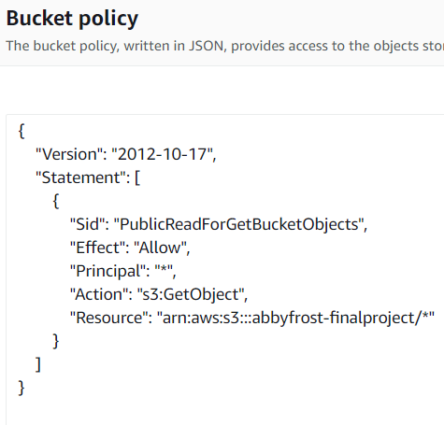
Creating S3 Bucket

Slide 8
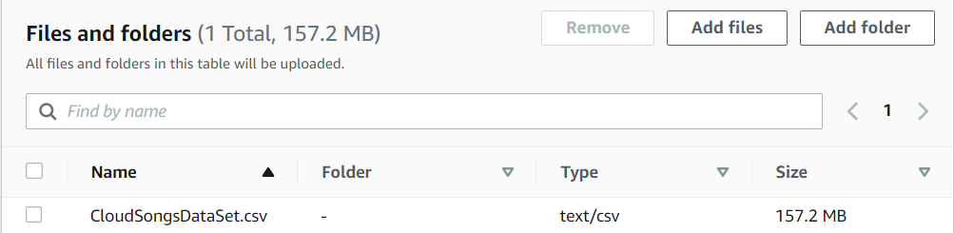
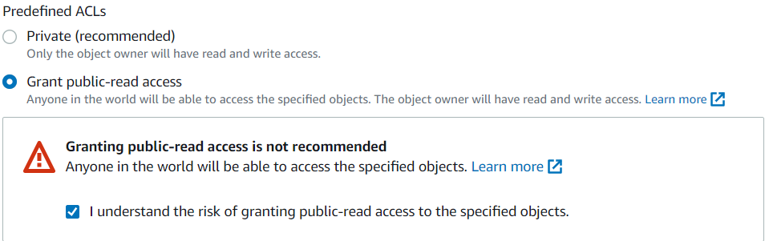
Upload DataSet of S3 Bucket

Slide 9
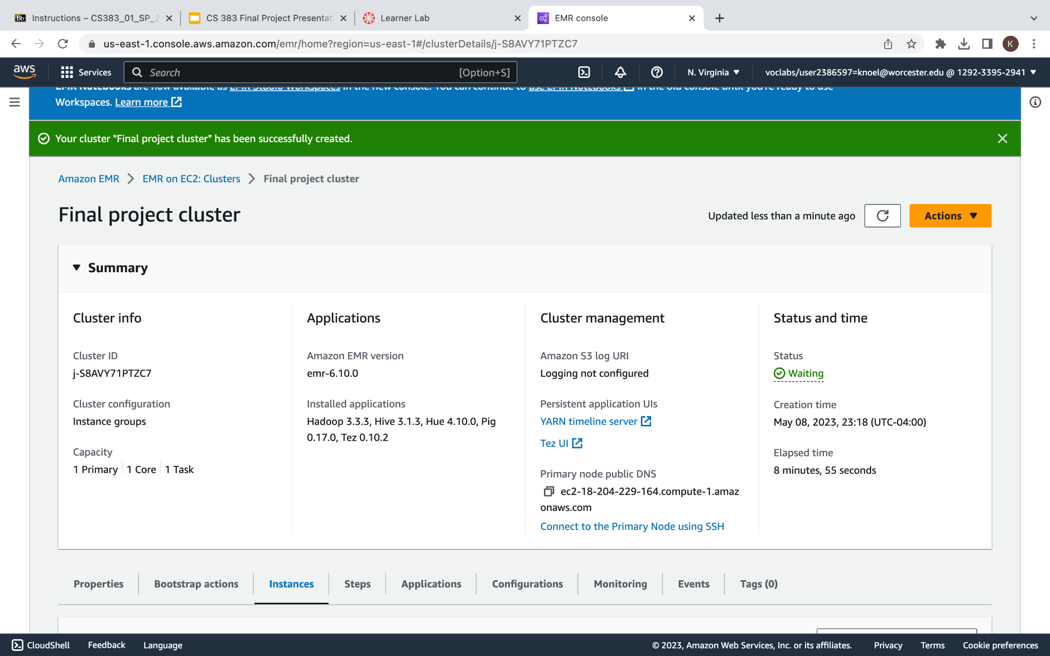
Creating EMR clusters
In order to create the cluster you have to create a key pair on EC2
Then create a bucket on s3 and add our CloudSongsDataset.csv
Create a Cluster on EMR
Connect your key pair to your cluster
After creating you cluster, Look for the status to turn green to connect it to the SSH mode

Slide 10
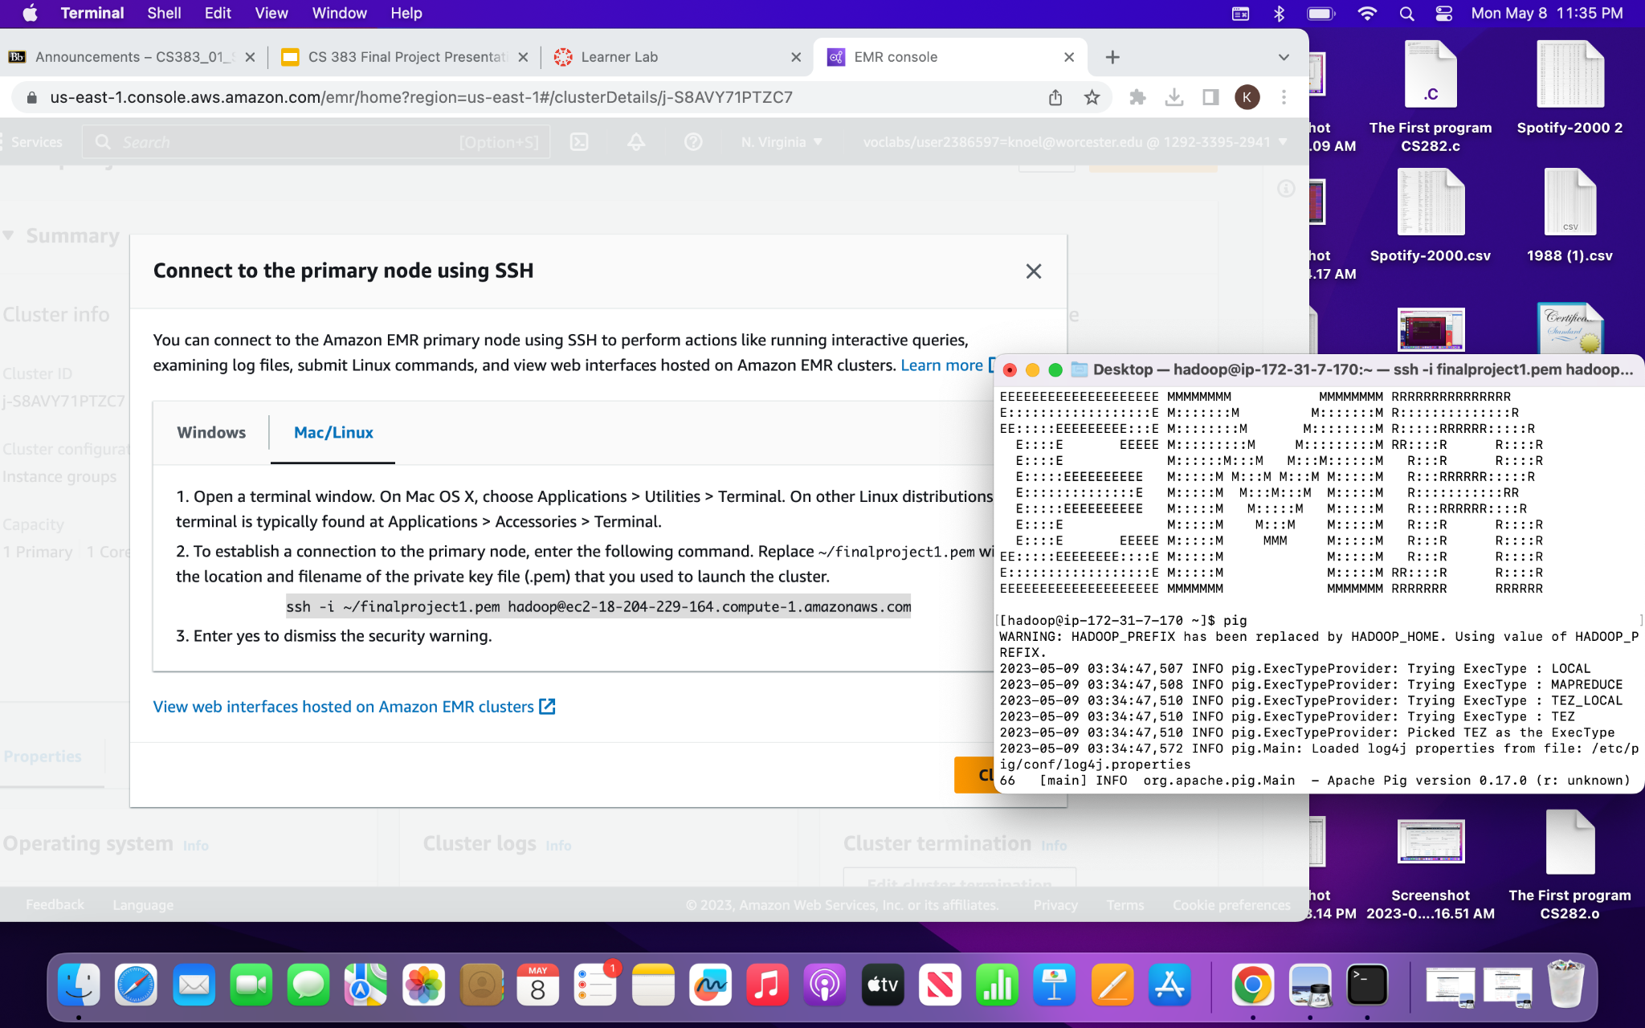
EMR Clusters

Slide 11
EMR Clusters Results

Slide 12
Total Views

Slide 13
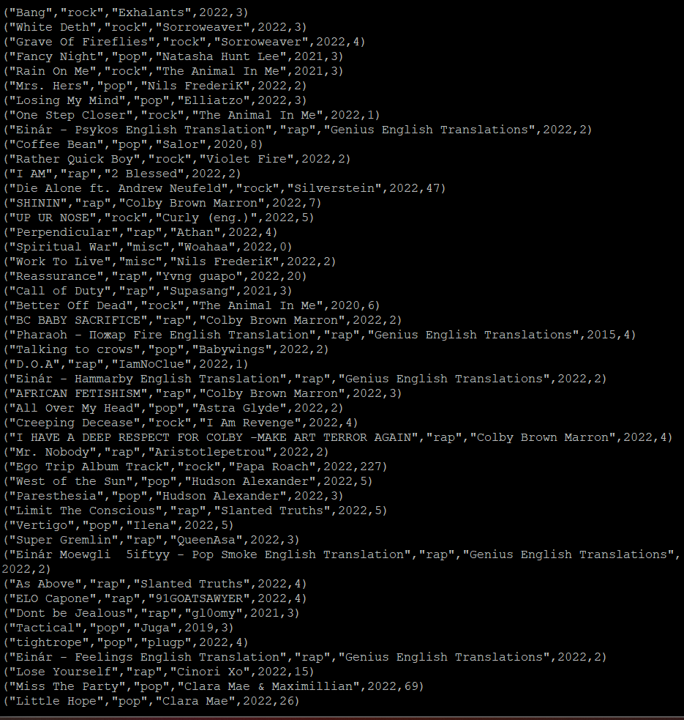
Total Views 2015 and Later

Slide 14
Total Views Before 2015

Slide 15
Results
Total Views: 11,971,700,266
Total Views 2015 or Later: 6,902,307,718
Total Views Before 2015: 5,034,765,428

Slide 16
What We Would Do Differently - EMR Clusters
Use spark more than hadoop, It was a little more difficult to use hadoop because of the LOAD instructions
Find a easier way for the LOAD instructions to work with our data set better
Have a better way of keeping track of the clusters and different instances

Slide 17
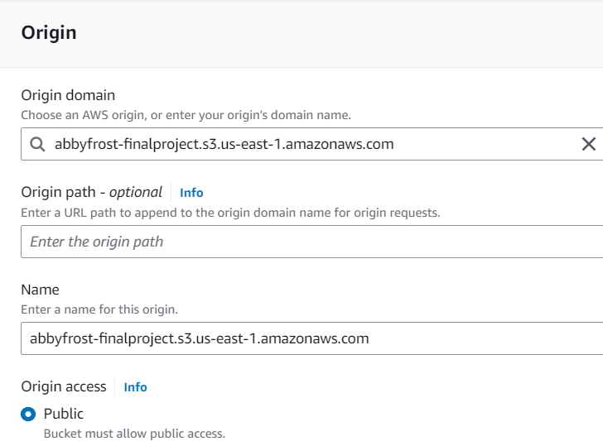
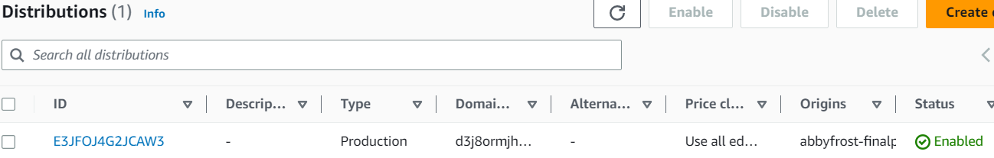
Creating CloudFront Distribution

Slide 18
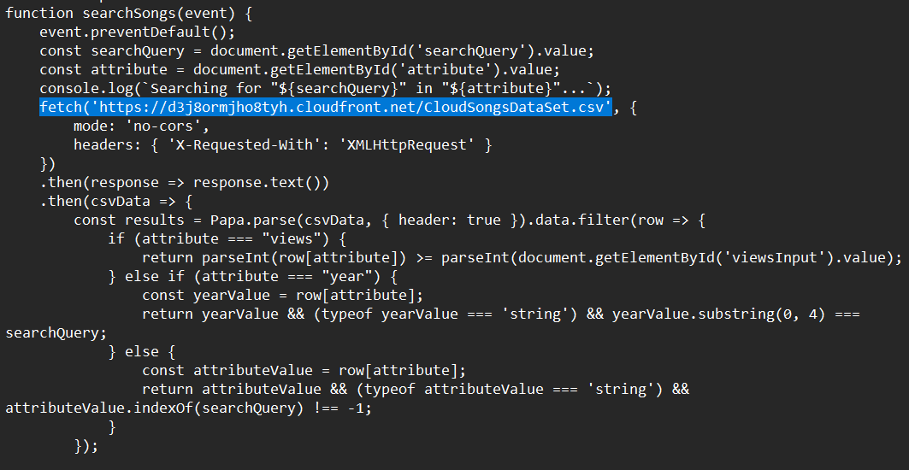
Creating HTML File

Slide 19
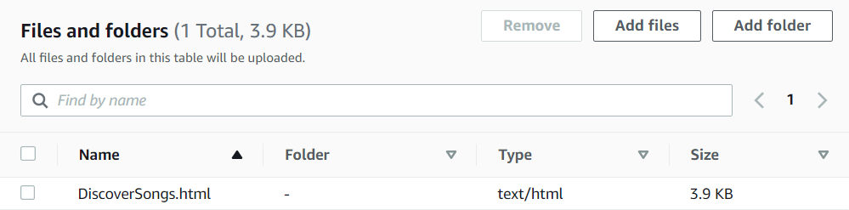
Upload HTML File into S3 Bucket
Make sure the file is public

Slide 20

Set the Distribution’s Default Root

Slide 21
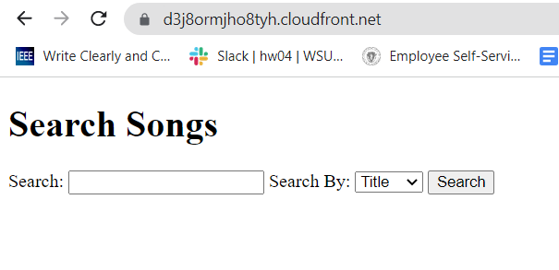
Enter the Domain Name

Slide 22
CloudFront Results

Slide 23

Time-Out Error :(
Occurs because the dataset is so big that the website times out before all rows have been checked.

Slide 24

Pre-Processing Again
Deleted 3,200,000 random rows
Re-did the previous steps but with the updated csv

Slide 25
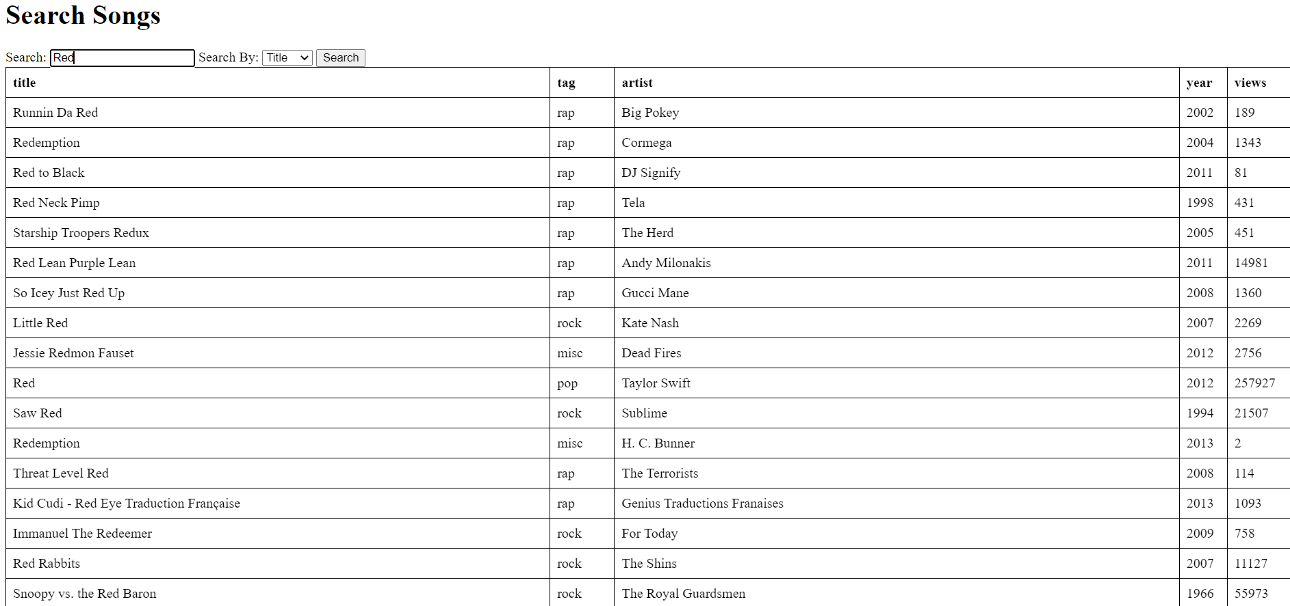
Search by Title

Slide 26
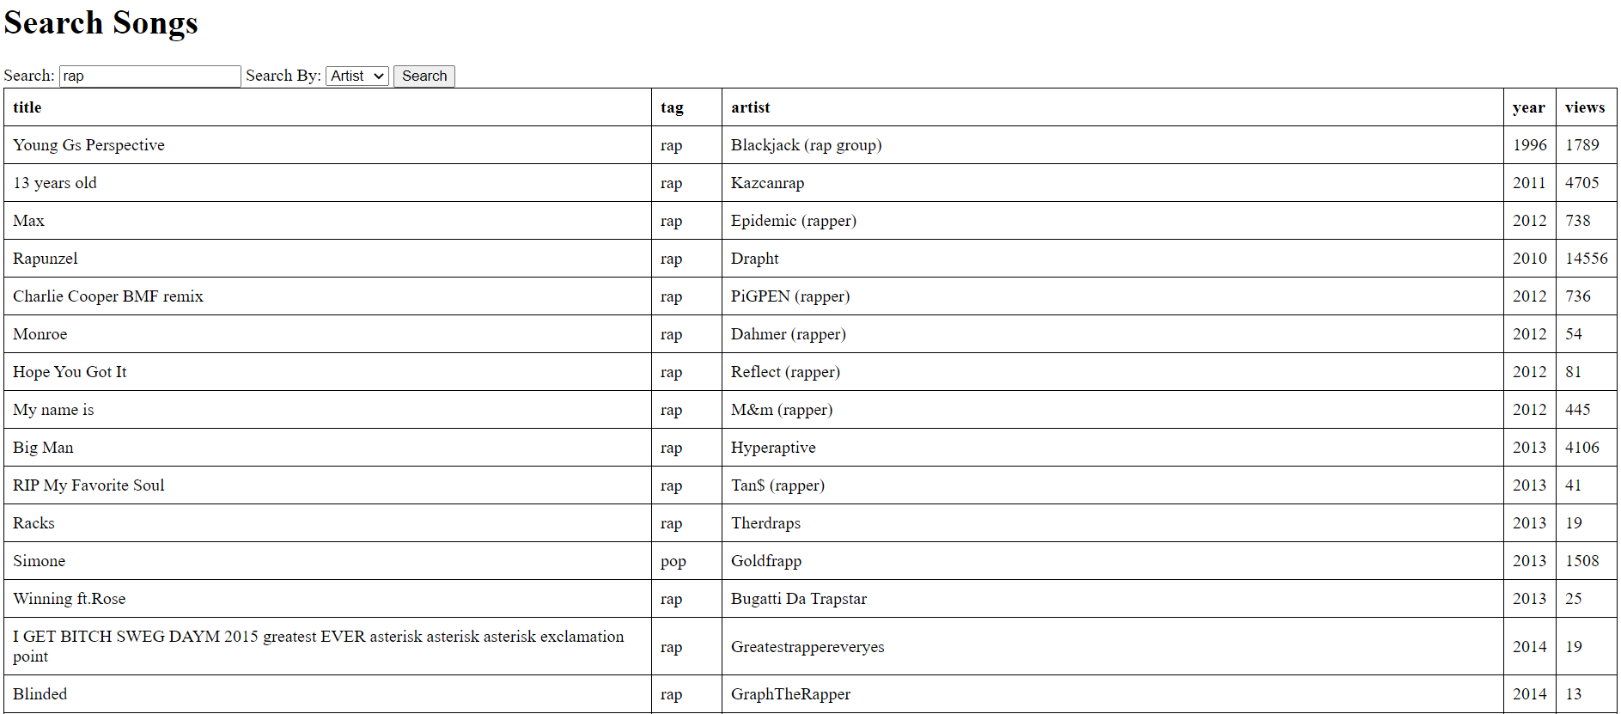
Search by Tag

Slide 27
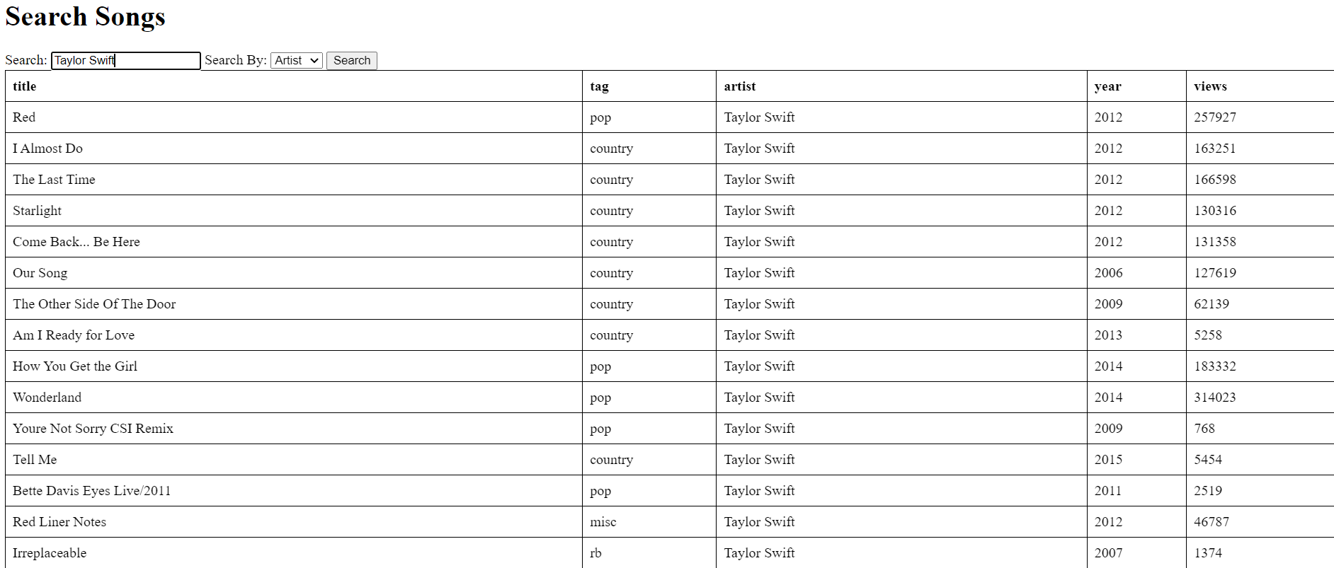
Search by Artist

Slide 28
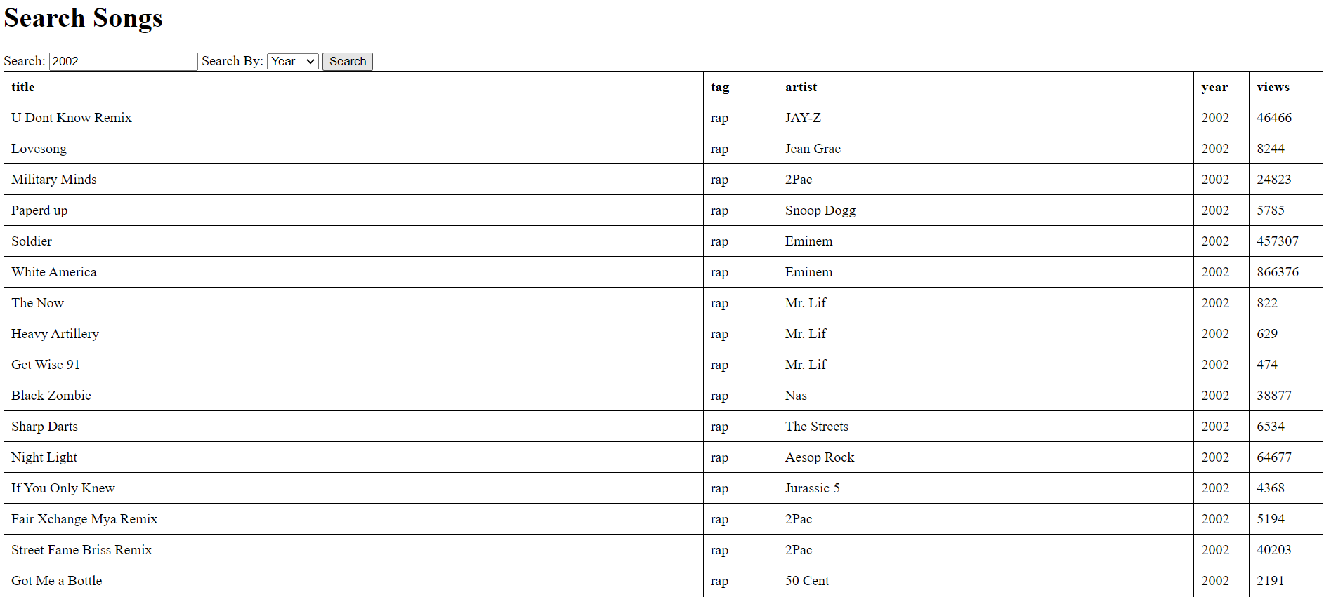
Search by Year

Slide 29
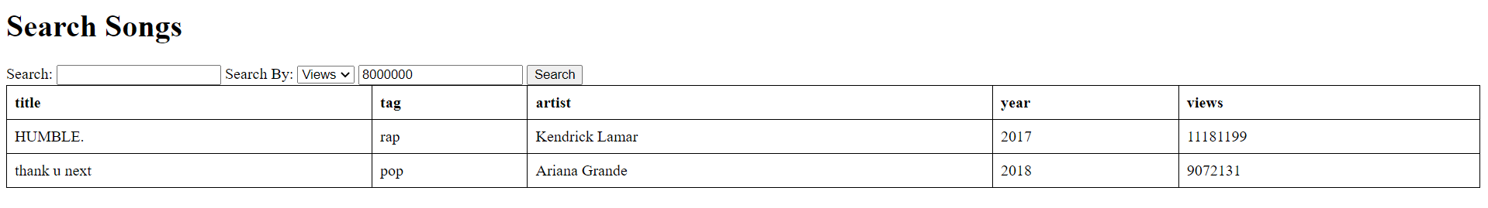
Search by Views

Slide 30
Most Important Things We Learned
CloudFront Distributions
The importance that the files and S3 buckets are public
Ensuring that distributions are disabled when not in use
Coding in HTML

Slide 31
What We Would Do Differently - CloudFront
Make the input case-insensitive
Update the method so when searching for a “title” the output will display results with the exact matched string
Filter the results

Slide 32
Errors/Issues
Never ending queries
User errors while clustering
Too big of a dataset
Causes long loading times
LOAD instructions had a hard time with data set
Had trouble connecting to the master mode
Hard time getting results from EMR spark and hadoop clusters

Slide 33
Resources
Arias, J. (2021, January 5). Building a simple website that outputs results from a CSV using user’s input. Medium. https://levelup.gitconnected.com/building-a-simple-website-that-outputs-results-from-a-csv-using-users-input-bfcb782ced45
Frank, & Frank Moraes is an editor and writer at HTML.com and other nerdy websites. (2020, January 1). HTML For Beginners The Easy Way: Start Learning HTML & CSS Today Read more: https://html.com/#ixzz81L0BuhUy. HTML. https://html.com/
Raza. (2023, April 24). English songs lyrics. Kaggle. https://www.kaggle.com/datasets/razauhaq/english-songs-lyrics

